Slide 1
January 31, 2022
Optum Care Mercury Requests
Owner
Tech Financial Ops Team, Louis A. Boney, The Data Squad, Paul J. Friend, Ryan Nishimoto
Filters
Commodity Rollup contains IT/Telecom
Region Name contains CA, Central, Mountain West and 7 more

Slide 2


Filters
Commodity Rollup contains IT/Telecom
Region Name contains CA, Central, Mountain West and 7 more

Slide 3
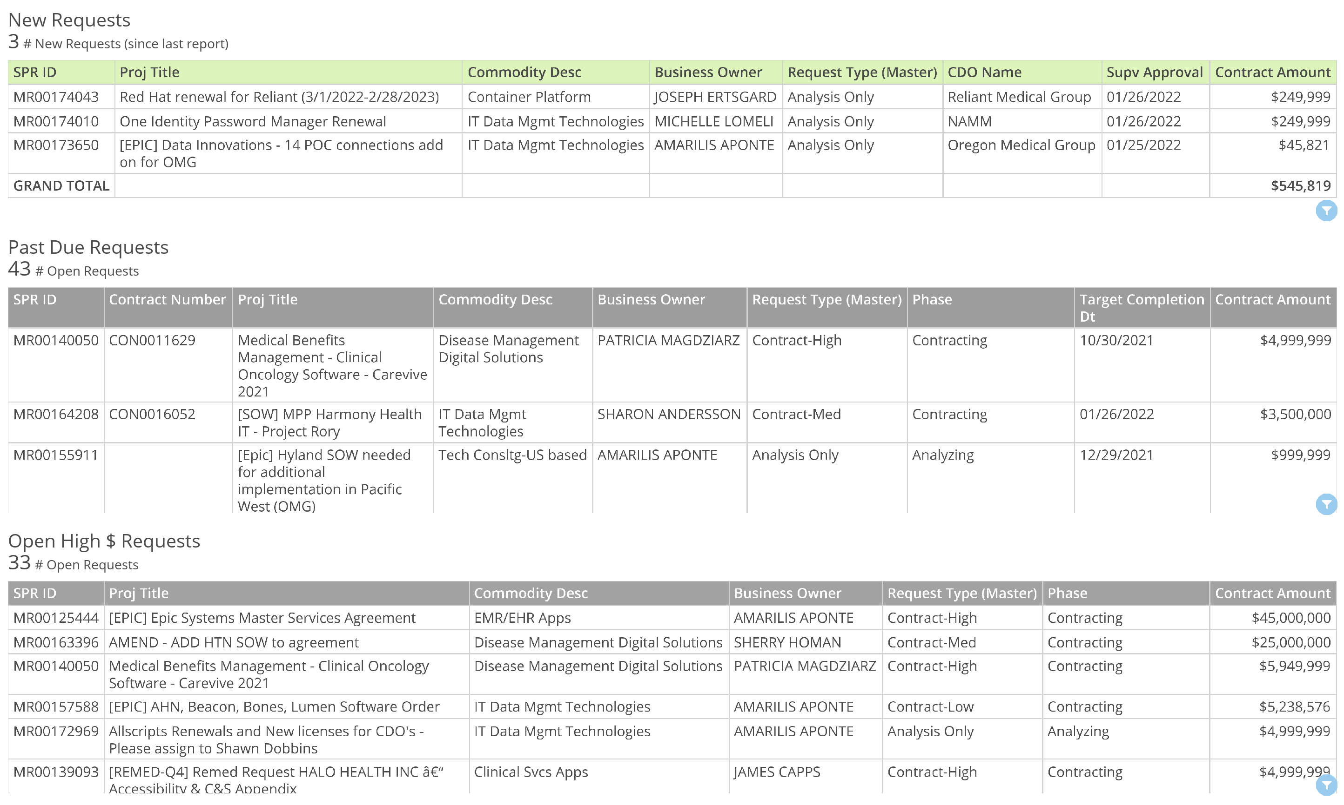
Filters
Commodity Rollup contains IT/Telecom
Region Name contains CA, Central, Mountain West and 7 more

Slide 5
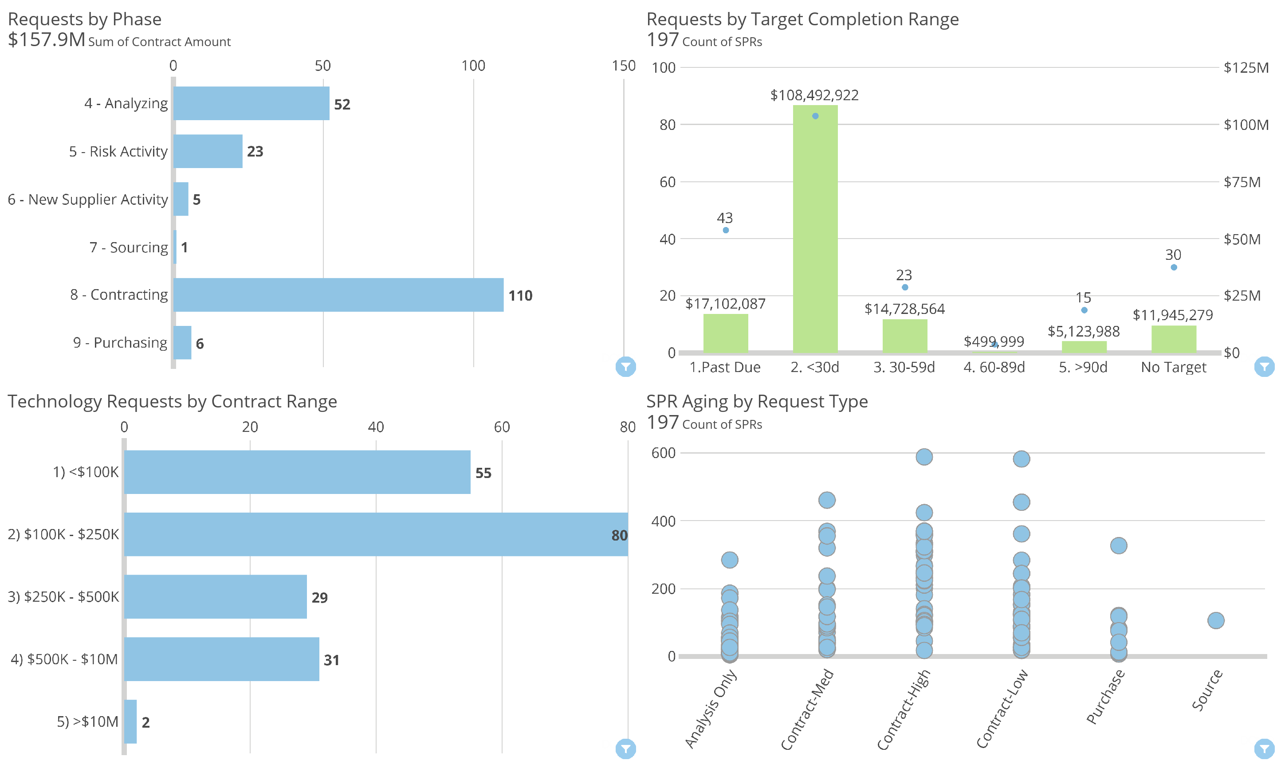
Filters
Commodity Rollup contains IT/Telecom
Region Name contains CA, Central, Mountain West and 7 more

Slide 6
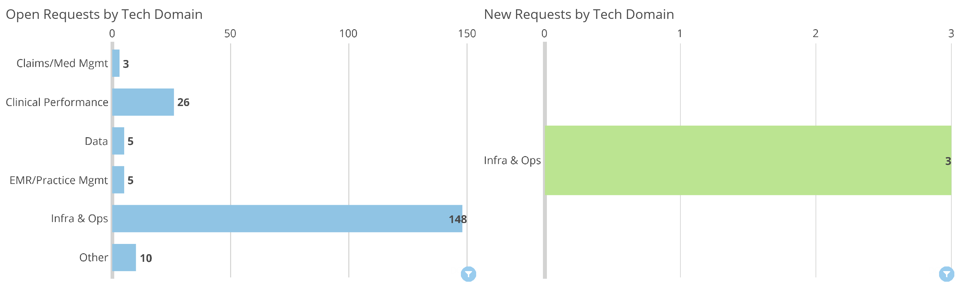
Filters
Commodity Rollup contains IT/Telecom
Region Name contains CA, Central, Mountain West and 7 more

Slide 7
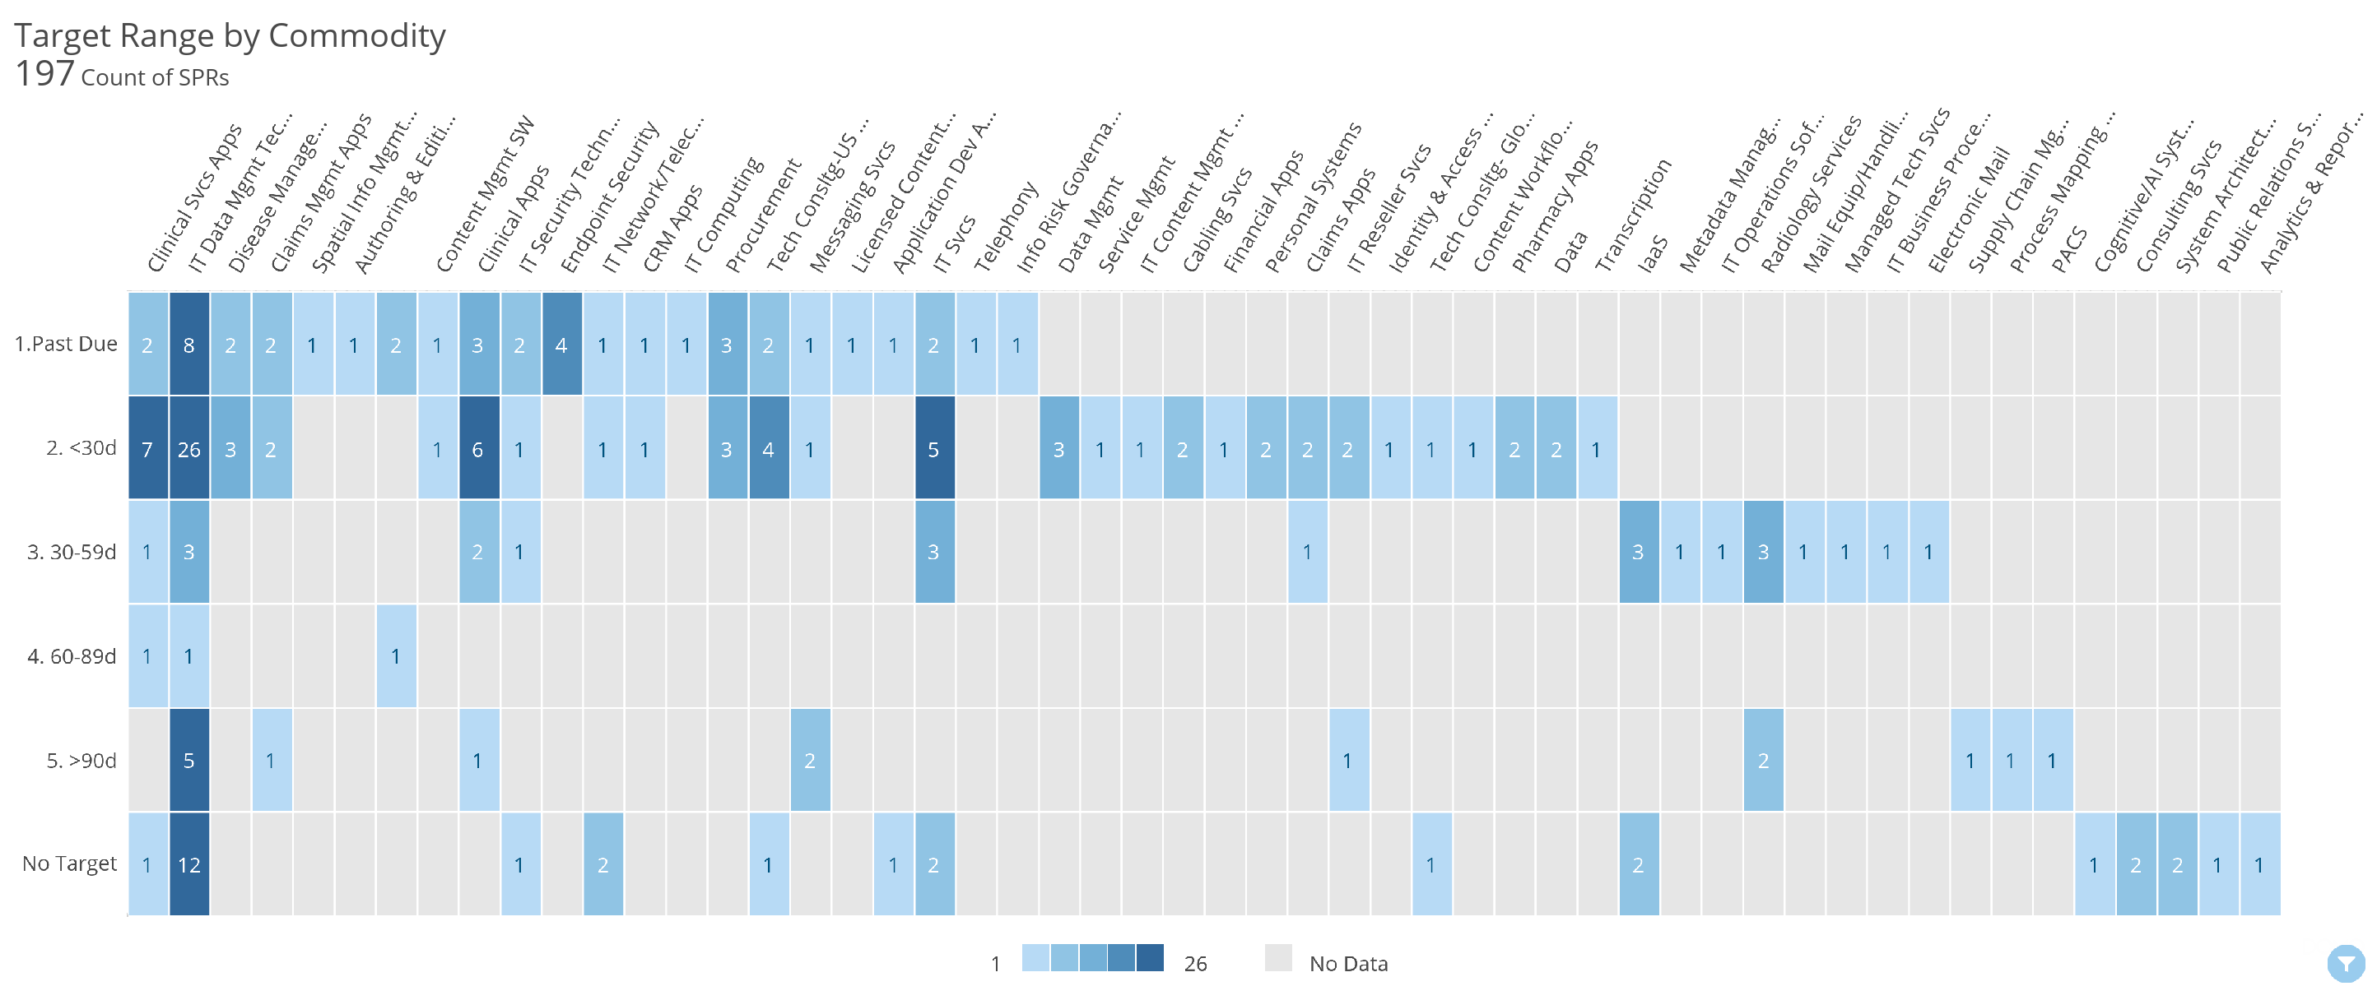
Filters
Commodity Rollup contains IT/Telecom
Region Name contains CA, Central, Mountain West and 7 more

Slide 8
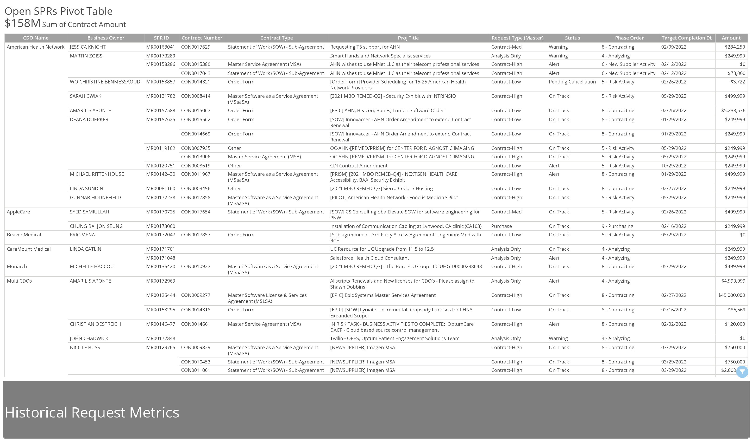
Filters
Commodity Rollup contains IT/Telecom
Region Name contains CA, Central, Mountain West and 7 more

Slide 9
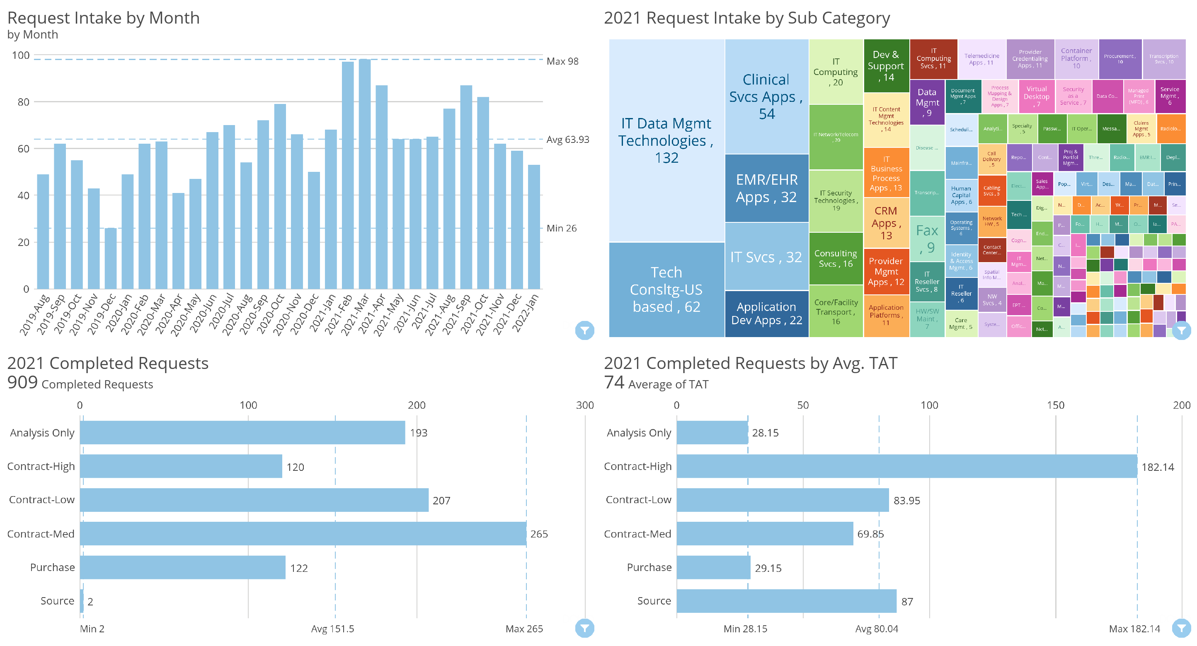
Filters
Commodity Rollup contains IT/Telecom
Region Name contains CA, Central, Mountain West and 7 more

Slide 10
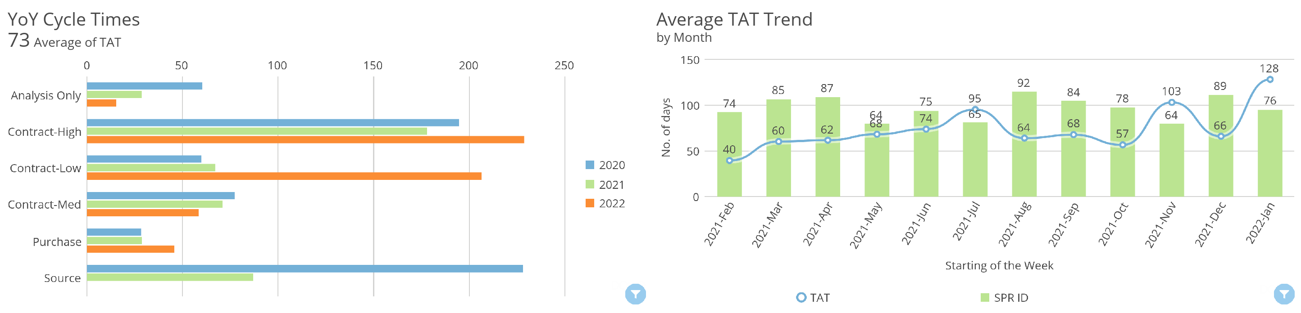
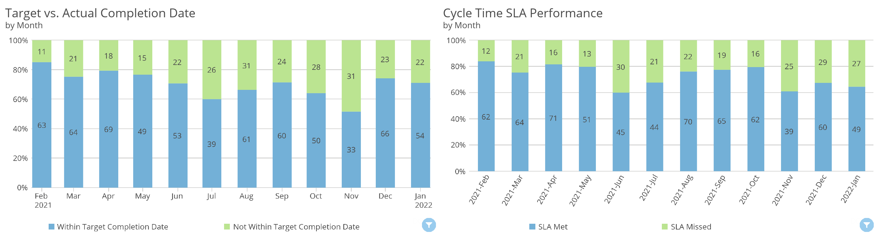
Filters
Commodity Rollup contains IT/Telecom
Region Name contains CA, Central, Mountain West and 7 more

Slide 11
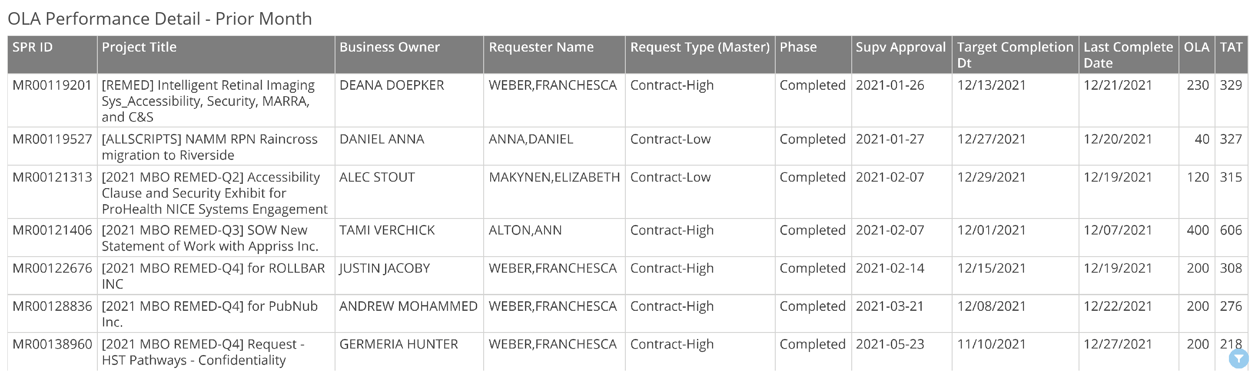
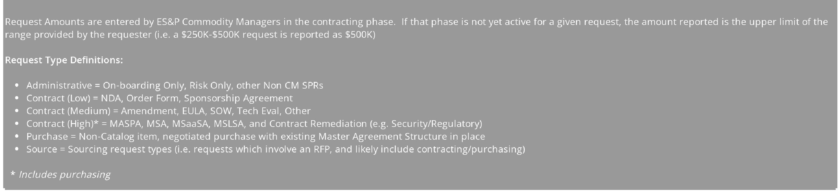
Filters
Commodity Rollup contains IT/Telecom
Region Name contains CA, Central, Mountain West and 7 more

Slide 12
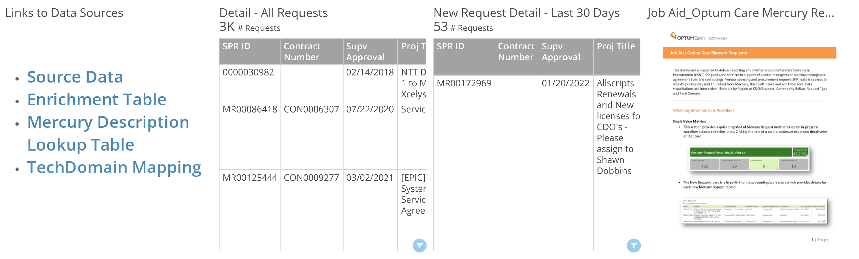
Appendix
Filters
Commodity Rollup contains IT/Telecom
Region Name contains CA, Central, Mountain West and 7 more

